Slide 1
Module No 11
UIPATH ADVANCE FEATURES

Slide 2
Learning Objectives
Working with GitHub
Working with New Features AI Center

Slide 3
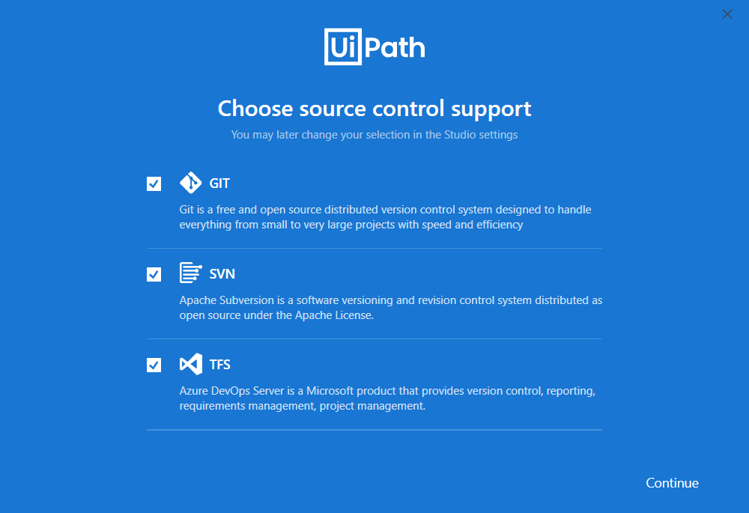
Steps for UiPath’s Integration With GIT
Source control systems prove very handy when developing larger projects that require smooth collaboration between multiple users. Studio offers the tools to connect automation projects to version control systems through the Team tab in the Backstage view.
Option | Description
Commit | Commits current changes to the local GIT repository.
Push | Pushes the current version onto the remote repository.
Pull (rebase) | Pulls remote files and rebases the current branch.
Manage Branches | Opens the GIT window with options for managing currently added branches.
Show Changes | Opens the File Diff window for comparing changes between the local version and the remote version of the file.
Show History | Opens the Show History window for comparing two versions of the same file.
Undo | Opens the Undo Pending Changes window if the file was not committed or pushed to the remote repository.

Slide 4
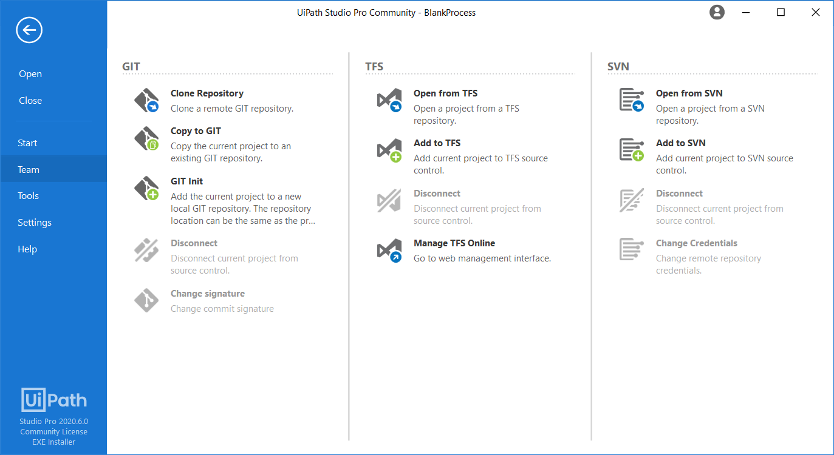
UiPath’s Integration With GIT
Create your free GitHub account at https://github.com/
Now you try creating a New Repository by Clicking New Repository. [Treat this as folder where all your code will be saved. Give it a meaning full name..]
Now let us connect our GIT account with the UiPath Studio. In the “Team” tab, select “Clone a GIT repository” as shown below and start entering the “Repository URL” that you have just created and provide a local path directory to clone it to with remote GIT repository.
And finally, provide your login credentials (.i.e User and password OR Token)
After cloning a GIT repository to a local working directory, the .git subdirectory is created containing the necessary GIT metadata.
Now create a UiPath workflow and perform a right click on the project and you should be able to see the options for Push, Pull, Manage Branches etc.
You should be able to perform required operation from here.
Covering the GitHub Working is beyond the scope of this Course… Its just to give you idea on how version control can be integrated.

Slide 5
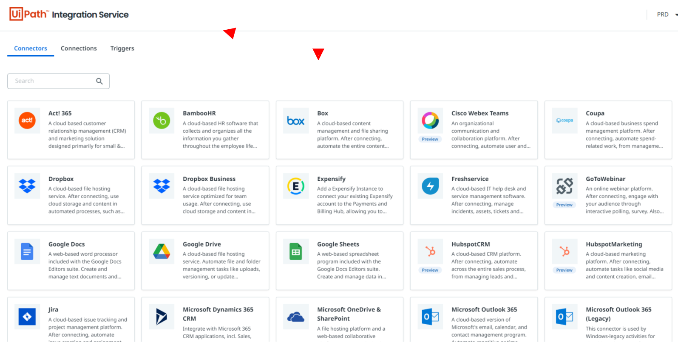
UiPath Integration Service
In general terms “Integration Service” is the process of connecting different systems (sub-systems or external systems).
The goal is very simple, Integration is required so that different systems can “talk to each other” speeding information flow and reducing the time to market.
Another important fact is modern business processes require more connected systems and UI and API Automation both are required for managing automation effectively.
Why UiPath Integration Service
Bi-directional workflow integrations
Large Library of Connectors
Easily set up and manage connections with standardized auth
Provides a seamless transition between Ui and API based automation

Slide 6
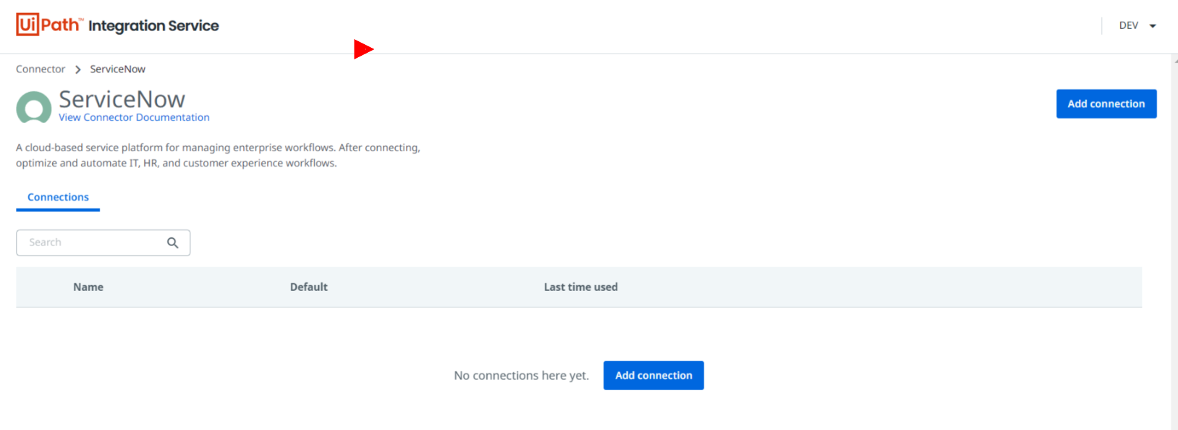
UiPath Integration Service
What are Connectors –
“Connectors” are nothing but pre-built API integration that provides a way to perform options in the target system. It usually consists of authorization and authentication for the systems you want to integrate. It further provides a way to manage the records in the target system with the help of “Activity Packs”.
You don’t need to re-invent the wheels for the standardized operation you can do in the target application.
Connectors can be accessed from the Integration service page -> Connectors Tab.
What are Connections –
“Connectors” uses “Connections” – You can treat them as a token for authentication and authorization. You can create as many connections as you need and set the required one as default in case much connection for the same services.
What are New Activity packs –
New Activity packs uses connections and leverage the Integrations service to provide easy accessibility for performing various operations.
What are Triggers –
Triggers provide a uniform mechanism for subscribing to events from the Connector platforms.

Slide 7
Performer Dispatch Design Pattern
Dispatcher
Performer
Dispatcher is Responsible for creating the data that need to be processed, Such as Looking for email, Tickets from Different Social Media Accounts etc. Or getting Data from Different sources to Create “Queue Items”
Performer is responsible to Work on Items produced by Dispatcher in such a way that if required we can have multiple performer to do same task.
Steps performed by the Robot in the Dispatcher:
1. Log in to [https://www.acme-test.com](https://www.acme-test.com/).
2. On the landing page, Dashboard, click or hover over the Invoices menu item and then click on Search for Invoice. Click on Display All Invoices.
3. Scrape the data from the whole table displayed.
4. For each row in the datatable, Add a queue item containing the Invoice Number, Vendor Tax ID and Invoice Item.
5. Close ACME System 1.
Steps performed by the Robot in the Performer:
1. Log in to [https://www.acme-test.com](https://www.acme-test.com/).
2. For each Queue Item:
- Click or hover over the Invoices menu item and then click on Search for Invoice;
- Type the Invoice Number retrieved from the queue item into the Invoice Number field field;
- Click on Search;
- Extract the values for the Vendor Tax ID and Invoice Item and compare them with the values from the queue item (check for EXACT match for all fields!);
- If the values are not matching, this should be categorized as a Business Rule Exception, and the queue item should have the status set accordingly;
- If the values match, the transaction is successful.
Note: Navigation can be achieved in multiple ways by the robot - choose whichever you find best.

Slide 8
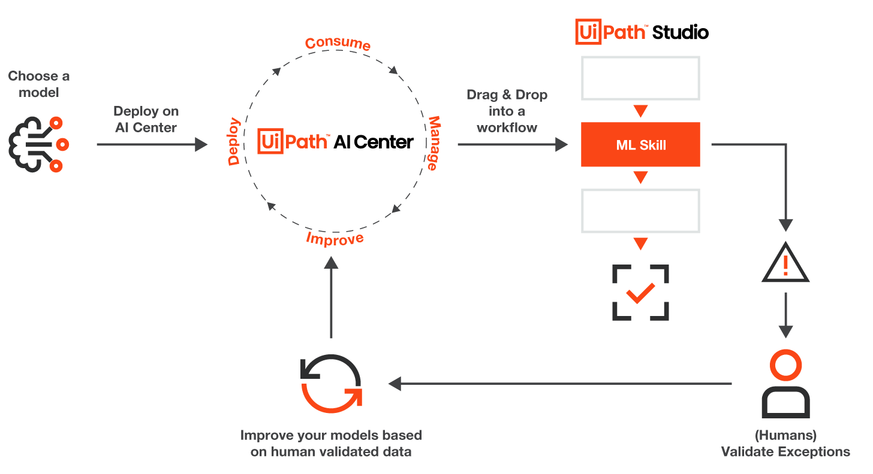
UiPath AI Center
UiPath AI Center is a service that allows you to deploy, manage, and continuously improve Machine Learning models and consume them within RPA workflows in Studio. This chapter treats the subject of model deployment and management which is done through the AI Center web application available through your Automation Cloud Portal.
You can think AI Center as another container(Not wise to say ML Lab) where you can create/manage and deploy your own machine learning model for consumption into intelligent automation workflow.

Slide 9
UiPath AI Center
Types of machine learning models on AI Center
•Bring your own model: models built by your data science team.
•Open-source model: models built by the data scientist community. Customers will be able to manage them in AI Center and train and deploy them directly in the RPA workflows.
•Pick a model: models built by UiPath technology partners.
•Out-of-the-box models: pre-built models supported by UiPath.

Slide 10
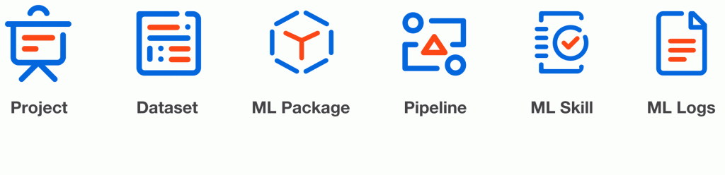
UiPath AI Center Working
Types of Machine Learning models on AI Center
You can reuse the models built by your data science team. You can upload your model into AI Center and deploy ML skills.
You will be also able to manage Open-source models built by the data scientist community in AI Center, train and deploy them in their workflows as per your use case.
Models built by UiPath’s technology partners, such as H2O.ai (As of now only limited information is available; let’s wait for product update.)
Out-of-the-box models built by UiPath.(Many Quick deployable models such as sentiment analysis, document understanding, language translator etc.)
To gain access to AI Center, change your licensing plan to Enterprise Trial or Enterprise and then allocate AI Robot licenses to your AI Center service within a tenant in your Automation Cloud organization.
Key Concepts Used on on AI Center
Projects – You can think of the project as a group of isolated resources for a specific ML use case.
Datasets – A folder containing files and folders to train your model.
ML Packages -An ML Package is a folder with all the code and metadata needed to train and serve a Machine Learning model. It can have multiple versions.
Pipeline -A Pipeline is a description of an ML workflow, including all of the functions in the workflow and the order of execution of these functions.
ML Skills – A trained ML model with an acceptable level of performance is ready to be used in an automation
ML Logs – Dashboard to perform analysis on logs when something goes wrong with ML Package.

Slide 11
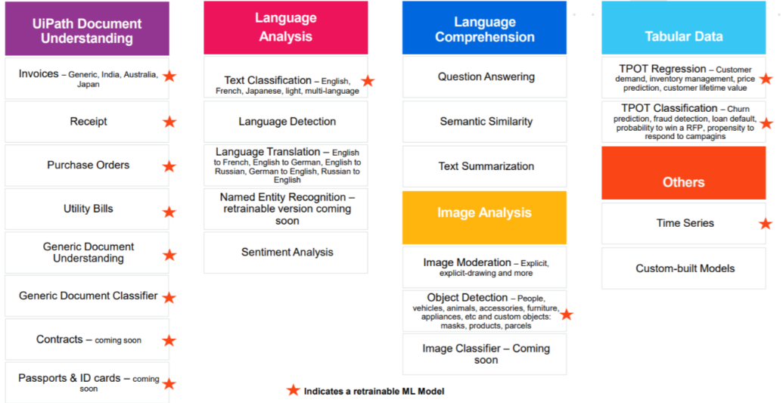
UiPath AI Center

Slide 12
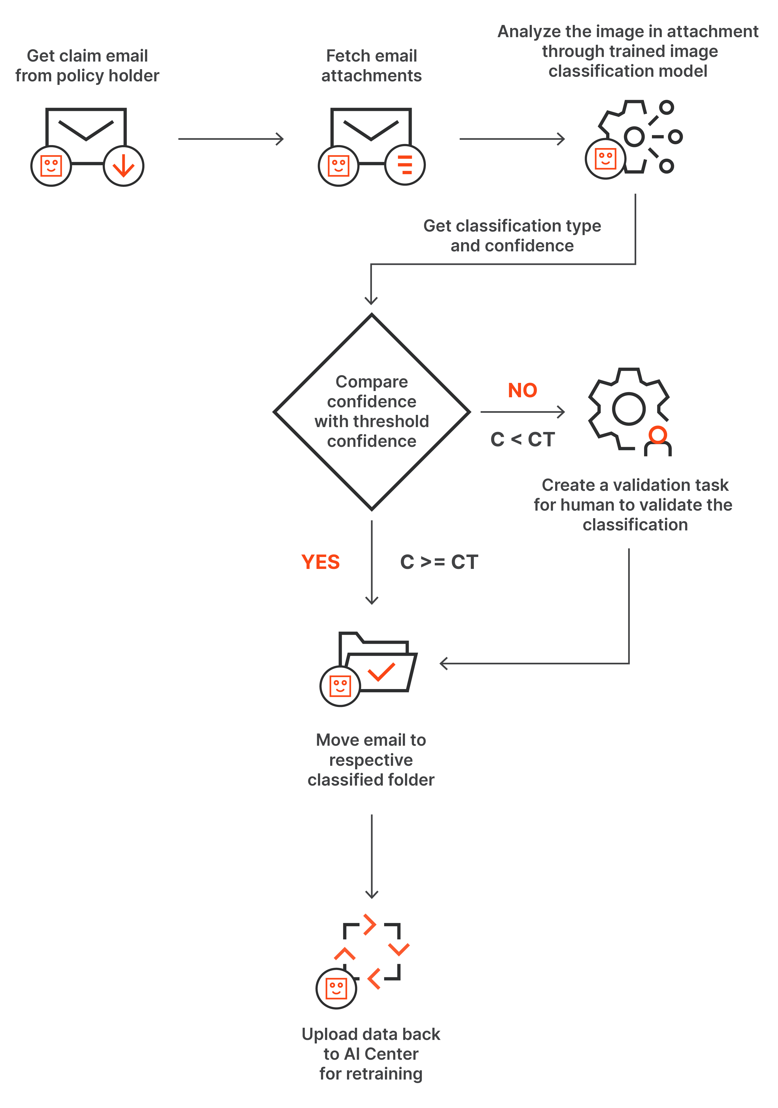
UiPath AI Center - RETraining

